Slide 1
Chapter 14
The Bureaucracy
American Democracy Now, 7th edition
Brigid Callahan Harrison
Jean Wahl Harris
Michelle D. Deardorff
Copyright 2022 © McGraw Hill LLC. All rights reserved. No reproduction or distribution without the prior written consent of McGraw Hill LLC.

Slide 2
Democracy and Bureaucracy 1
Bureaucrats: people employed in a government executive branch unit to implement public policy; public administrators; public servants.
Bureaucracy: the collection of all national executive branch organizations.
Unlike private, for-profit organizations, the bottom-line goal for government and the government bureaucracy is citizen satisfaction.

Slide 3
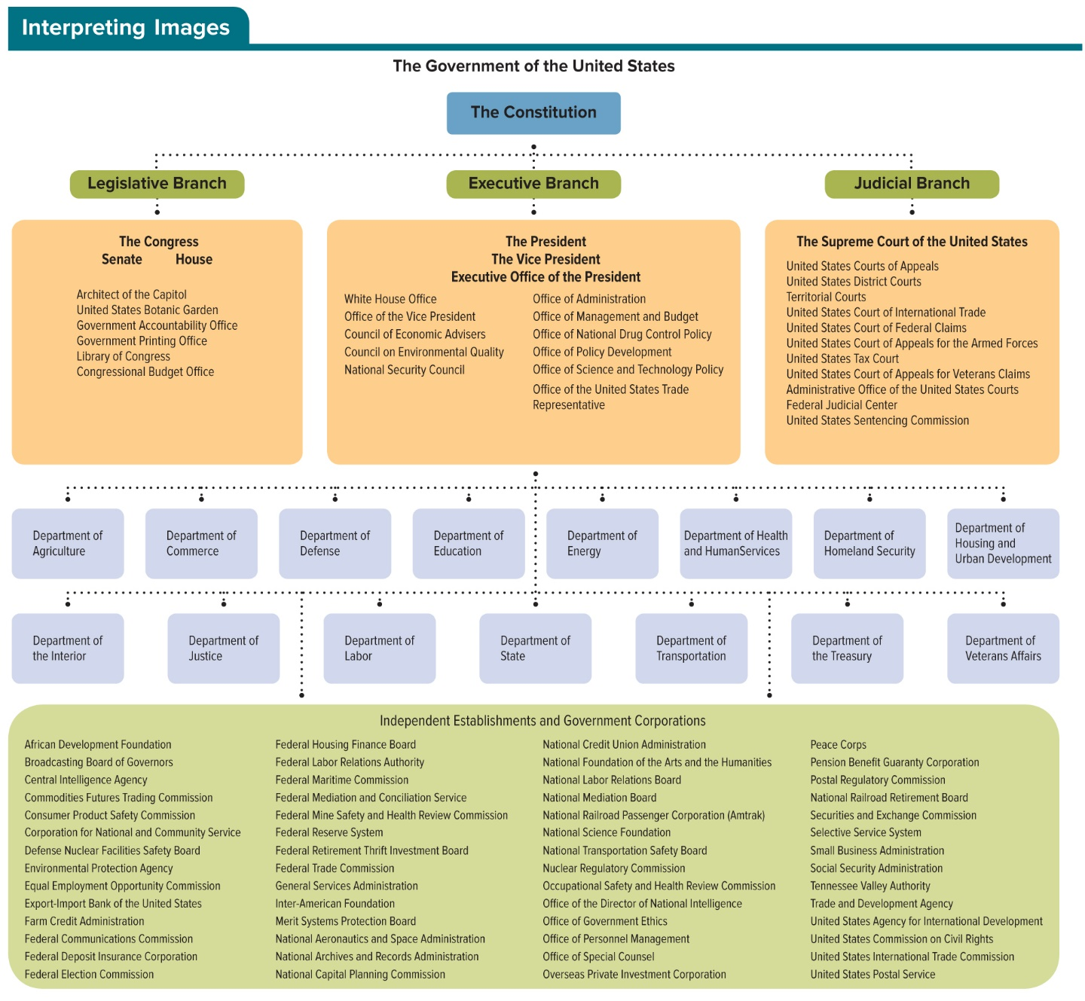
Figure 14.1 U.S. Government Organizational Chart
Access the text alternative to slide image

Slide 4
Democracy and Bureaucracy 2
Bureaucrats provide the public services that elected officials authorize, and in doing so they make decisions that affect people daily.

Slide 5
Democracy and Bureaucracy 3
Max Weber (1864 to 1920), the “father of sociology,” coined the word bureaucracy to describe organizations with the following features:
Division of labor.
Specialization of job tasks.
Hiring systems based on worker competency.
Hierarchy with a vertical chain of command.
Standard operating procedures, rules, and regulations.
Red tape: rules and procedures viewed as inefficient.
Bureaucratic structure is not unique to government.

Slide 6
The Bureaucrats Who Implement Federal Policies
Political scientists distinguish among national bureaucrats according to several factors, including the process by which they are hired, the procedures by which they can be fired, and the grounds for which they can be fired.
On the basis of these factors, we can differentiate among three categories of national civilian bureaucrats: (1) political appointees, (2) senior executive service employees, and (3) civil servants.

Slide 7
Political Appointees
Plum book lists the top jobs in the bureaucracy, which are filled by presidential appointment.
President fills these thousands of plum jobs using the patronage system, rewarding loyal supporters.
President not only hires but also fires political appointees at his or her pleasure.

Slide 8
Senior Executives
Senior Executive Service (SES) is composed of the top managerial, supervisory, and policy positions that link the political appointees to the rest of the federal bureaucracy.
SES bureaucrat is a hybrid of the political appointee and the civil servant.
At least 90 percent are career appointees hired based on merit through an open, competitive process.
Remaining are noncareer and temporary appointees hired similar to political appointees.

Slide 9
Civil Servants
During the first century of U.S. history, all federal bureaucrats were hired through the patronage system.
In the merit-based civil service, individuals are hired on the basis of the task or competence in a certain skill, with equal opportunity and political neutrality.
Civil servants: bureaucrats hired through a merit-based personnel system and who have job protection.

Slide 10
Open Competition, Competence, and Equal Opportunity
Today, merit-based civil service jobs, which compose the majority of the federal bureaucracy, are open and accessible to all who wish to compete.
Competition requires that candidates prove their competence to do the job (their merit).
Civil service is moving closer to a representative bureaucracy, one that resembles the demographic characterizes of the larger population.

Slide 11
Table 14.2 Education Requirements and Salary Ranges for white-Collar Federal Civil Servants (2020)
LEVEL | SALARY RANGE | QUALIFYING EDUCATION
GS-1 | $19,543 to $24,448 | No high school diploma required
GS-2 | $21,974 to $27,653 | High school graduation or equivalent
GS-3 | $23,976 to $31,167 | One academic year above high school
GS-4 | $26,915 to $34,988 | Two academic years above high school, or associate’s degree
GS-5 | $30,113 to $39,149 | Four academic years above high school leading to a bachelor’s degree, or a bachelor’s degree
GS-6 | $33,5676 to $43,638 | Experience required in addition to the stated level of education
GS-7 | $37,301 to $48,488 | Bachelor’s degree with superior academic achievement or one academic year of graduate education or law school
GS-8 | $41,310 to $53,703 | Experience required in addition to the stated level of education
GS-9 | $45,627 to $59,316 | Master’s (or equivalent graduate degree) or two academic years of progressively higher level graduate education
GS-10 | $40,246 to $65,321 | Experience required in addition to the stated level of education
GS-11 | $55,204 to $71,764 | PhD or equivalent degree or three academic years of progressively higher level graduate education
GS-12 | $66,167 to $86,021 | Completion of all requirements for a doctoral or equivalent degree (for research positions only)
GS-13 | $78,681 to $102,288 | Appropriate specialized experience
GS-14 | $92,977 to $120,868 | Appropriate specialized experience
GS-15 | $109,366 to $142,180 | Appropriate specialized experience
Table divided into three columns summarizes education requirements and salary ranges for white-collar federal civil servants (2020). The column headers are marked from left to right as: Level, salary range, and qualifying education.
SOURCES: 2020 Base GS Pay Scale, https://www.federalpay.org/gs/locality.

Slide 12
Political Neutrality
Civil servants cannot be fired merely because someone with different political beliefs is elected or appointed to supervise them.
They can be fired for:
Poor quality of work (misfeasance).
Nonperformance of their work (nonfeasance).
Violating the law or the rules and regulations that guide their work (malfeasance).
Hatch Act bolsters political neutrality by restricting some political activity of civil servants.

Slide 13
Managing the Federal Civil Service
Civil Service Reform Act, 1978, created three agencies to manage the federal civil service.
Office of Personnel Management (OPM) is responsible for developing and implementing merit-based civil service personnel policies and procedures.
Merit System Protection Board (MSPB) ensures proper implementation of the merit system by investigating allegations of improper implementation .
Federal Labor Relations Authority (FLRA) monitors relations between unionized bureaucrats and the federal government.

Slide 14
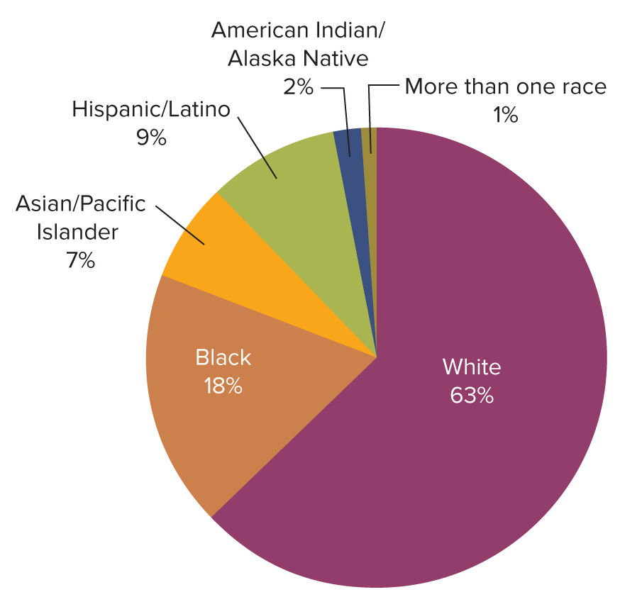
Figure 14.2 Race/National Origin of Federal Bureaucrats
Access the text alternative to slide image

Slide 15
Unionized Civil Servants
Thirty-one percent of U.S. federal civil servants belong to labor unions.
Unionized civil servants have leverage to negotiate certain conditions of work.
Cannot negotiate salaries or work hours, nor do they have the legal right to strike.

Slide 16
State, Local, and Shadow Bureaucrats 1
Joining the millions of national, state, and local bureaucrats are the so-called shadow bureaucrats—employees on the payroll of private for-profit businesses and private nonprofit organizations with government contracts.
Through a process of contracting-out (also called outsourcing or privatizing), the government signs work contracts with these organizations to assist in the implementation of national policy.

Slide 17
State, Local, and Shadow Bureaucrats 2
Federal government expects that contracting-out will reduce the expense of government.
Even with the increased use of state, local, and shadow bureaucrats, the federal bureaucracy is neither small nor streamlined.

Slide 18
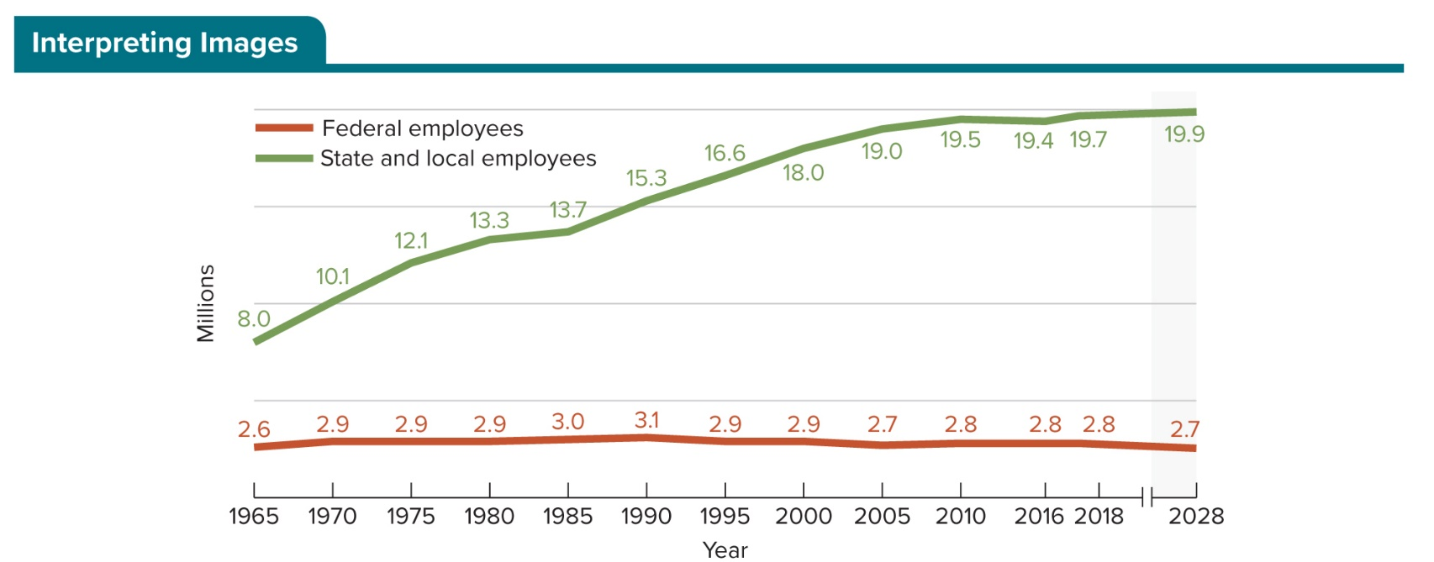
Figure 14.3 Growth in Civilian Workforce
SOURCES: U.S. Census Bureau. Statistical Abstracts of the United States. 1955, Table 476; 1968, Table 567; 1978, Table 504; 1990, Table 487; 2012, Table 461. 2016 data source: U.S. Bureau of Labor Statistics, Employment Projections program, Table 2.1 Employment by major industry sector, 2006, 2016, and projected 2026; .U.S. Bureau of Labor Statistics, Employment Projections program, Table 2.1 Employment by major industry sector, 2008, 2018, and projected 2028.
Access the text alternative to slide image

Slide 19
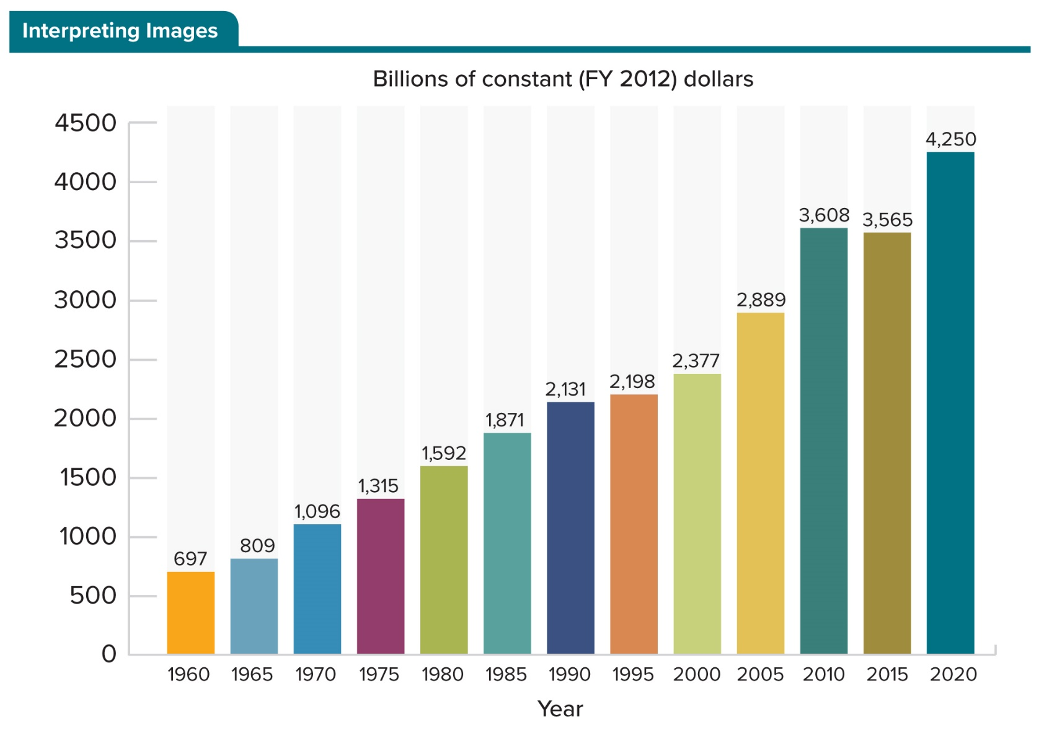
Figure 14.4 Trends in Federal Expenditures
SOURCE: Office of Management and Budget. Historical Tables, “Table 1.3—Summary of Receipts, Outlays, and Surpluses or Deficits in Current Dollars, Constant (FY 2012) Dollars, and as Percentages of GDP: 1940–202.”
Access the text alternative to slide image

Slide 20
The Evolution of the Federal Bureaucracy
Today, with the U.S. population of 330 million, hundreds of federal executive branch units implement volumes of national policies.
Employ close to 3 million civilian employees and 1.3 million active duty military personnel.
Five categories of executive branch organizations:
(1) Departments.
(2) Independent administrative agencies.
(3) Independent regulatory commissions.
(4) Government corporations.
(5) Agencies in the Executive Office of the President.

Slide 21
Departments
Department of Homeland Security, established in 2002, is the newest of 15 federal departments, each responsible for one broadly defined policy area.
President holds the 15 departments accountable through the appointment of a head official.
Secretary is the title of this top political appointee in all departments except the Department of Justice, where the head is the attorney general.

Slide 22
Table 14.3 Establishment of Cabinet Departments
DEPARTMENT | YEAR ESTABLISHED
State | 1789
Treasury | 1789
War | 1789
Army | 1798
Navy | 1798
Interior | 1859
Justice (Attorney General’s Office, 1789) | 1870
Agriculture | 1889
Commerce and Labor | 1903
Commerce (separated from Commerce and Labor) | 1913
Labor (separated from Commerce and Labor) | 1913
Defense (pulled War, Army, and Navy into one department) | 1947
Health, Education, and Welfare | 1953
Housing and Urban Development | 1965
Transportation | 1966
Energy | 1977
Health & Human Services (separated from Health, Education, and Welfare) | 1979
Education (separated from Health, Education, and Welfare) | 1979
Veteran’s Affairs | 1988
Homeland Security | 2002
Table divided into two columns summarizes establishment of cabinet departments. The column headers are marked as: Department and year established.

Slide 23
Independent Administrative Agencies
Host of independent administrative agencies are each responsible for a more narrowly defined function of the national government.
Structurally independent administrative agencies look like cabinet departments, with a single head appointed by the president.
Agencies are “independent” because they are outside of cabinet departments.
Agencies actually have varying levels of independence.

Slide 24
Independent Regulatory Commissions
Independent regulatory commissions are bureaucracies outside of the cabinet departments with the authority to:
Develop standards of behavior for specific industries and businesses,
Monitor compliance with these standards, and
Impose sanctions on those it finds guilty of violating the standards.
Their unique structure allows them to act independently of the president’s preferences.

Slide 25
Government Corporations
Like private businesses, government corporations sell a service or a product and compete for customers; but unlike private businesses, they are government owned.
U.S. Postal Service.
Bipartisan board typically directs each government corporation.

Slide 26
Executive Office of the President
Executive Office of the President (EOP) is composed of dozens of offices and councils that assist the president in managing the complex and sprawling executive branch of the bureaucracy.
President has the authority to fire these appointees at his or her pleasure.

Slide 27
The Work of Bureaucrats
Bureaucrats play an active, vital role in all six stages of the public policy cycle.
(1) Agenda setting.
(2) Policy formulation.
(3) Policy approval.
(4) Appropriation approval.
(5) Policy implementation.
(6) Policy evaluation.
Reality of public policy processes does not allow for a clean separation between those who “do politics” and those who administer policy.

Slide 28
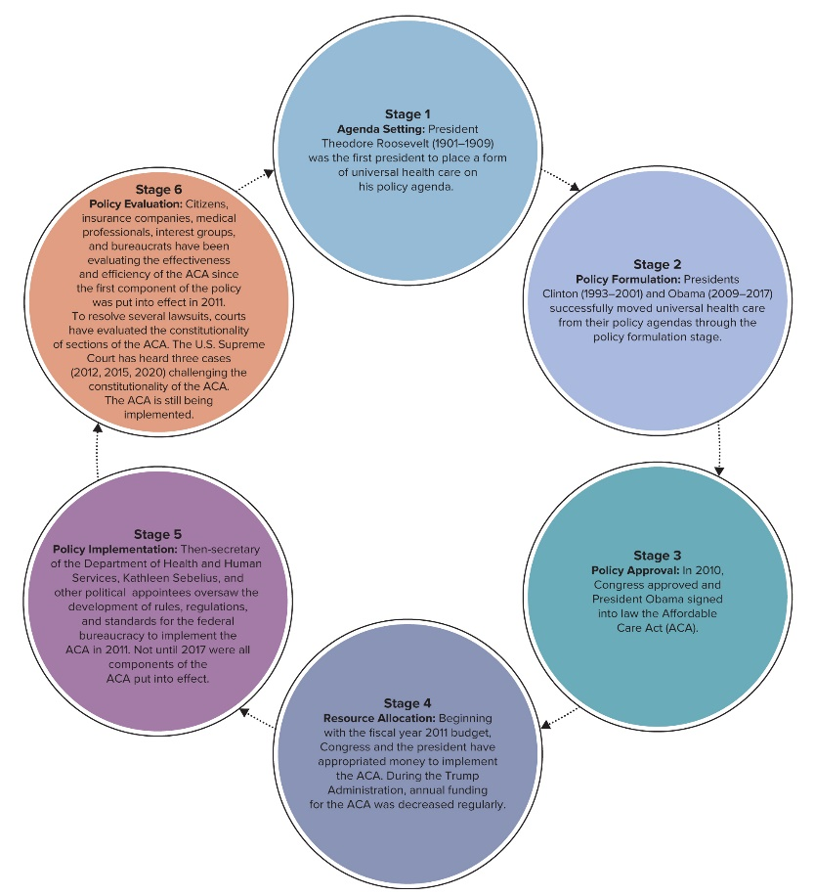
Figure 14.5 Stages of the Policy Process:
Stage 1 Agenda Setting: President Theodore Roosevelt (1901-1909) was the first president to place a form of universal health care on his policy agenda.
Stage 2 Policy Formulation: Presidents Clinton (1993-2001) and Obama (2009-2017) successfully moved universal health care from their policy agendas through the policy formulation stage.
Stage 3 Policy Approval: In 2010, Congress approved and President Obama signed into law the Affordable Care Act (ACA).
Stage 4 Resource Allocation: Beginning with the fiscal year 2011 budget, Congress and the president have appropriated money to implement the ACA. During the Trump Administration, annual funding for the ACA was decreased regularly.
Stage 5 Policy Implementation: Then-secretary of the Department of Health and Human Services, Kathleen Sebelius, and other political appointees oversaw the development of rules, regulations, and standards for the federal bureaucracy to implement the ACA in 2011. Not until 2017 will all components of the ACA be put into effect.
Stage 6 Policy Evaluation: Citizens, insurance companies, medical professionals, interest groups, and bureaucrats have been evaluating the effectiveness and efficiency of the ACA since the first component of the policy was put into effect in 2011. To resolve several lawsuits, courts have evaluated the constitutionality of sections of the ACA. The U.S. Supreme Court has heard three cases (2012, 2015, 2020) challenging the constitutionality of the ACA. The ACA is still being implemented.
This flowchart shows how the Affordable Care Act (ACA) continues to work through the policy cycle. In reality, the stages of the policy cycle often overlap. Today, additional rules and regulations are being established as the ACA is implemented. At the same time critics and supporters continue to evaluate the ACA, as are government agencies and courts. In 2021 the Supreme Court will again rule on the constitutionality of the ACA. In the meantime, calls for reform to the act may force it back to the agenda-setting stage, which could lead to the formulation of new legislation revising the ACA or even to repealing it.
Access the text alternative to slide image

Slide 29
Agenda Setting
Elected officials decide what issues they want to discuss and possibly address by placing them on their lists of items to work on—their policy agendas.
Bureaucrats play an instrumental role in setting the policy agenda.
Bureaucrats have a clear view of the societal problems that citizens expect the government to address and strong views on how best to address those problems.

Slide 30
Policy Formulation
Policy formulation involves defining a problem that has made it to an agenda and developing a plan of action to address it.
Bureaucrats often have specialized knowledge of societal problems, and elected officials rely on them when formulating policies.
Congress often includes vague or ambiguous language in bills, relying on bureaucrats to fill in the program details.

Slide 31
Policy Approval
Congress and the president vote to approve or reject a bill that presents a formulated public policy.
These authorization laws provide the plan of action to address a given societal concern and identify the executive branch unit that will put the plan into effect.
Majority of public policies rely on congressional and presidential approval of annual spending bills for their funding.

Slide 32
Appropriation Approval
Budget says where to spend money; appropriation laws give bureaucracies the legal authority to spend money during a specific fiscal year.
Bureaucrats’ role in the budget process:
Develop annual budget for their agencies.
Justify their budget to the Congress.
Lobby Congress to allocate the funds they requested.
Compete for limited funding.
When finally funded, put policy into action.

Slide 33
Policy Implementation
This stage is the main work of bureaucrats.
Types of authority delegated to administrators in order for them to implement policy:
Administrative discretion: using their expertise and judgment to best implement the policy.
Administrative rule making: filling in the details of a vague law with rules, regulations, and enforcement standards.
Administrative adjudication: resolve disputes over the implementation of their administrative rules.

Slide 34
Policy Evaluation
Policy evaluation involves assessing the intended and unintended effects of the policy implemented.
Effective bureaucratic performance is the key to citizens’ satisfaction with government and to government success.
Agencies document what they do and the impact of their work to prove their efficiency and effectiveness.

Slide 35
Bureaucratic Accountability
When it comes to public service, everyone is watching.
National sunshine laws open up government functions and documents to the public, ensuring transparency and the public’s right to know about government business and decision making.
Only effective if citizens know about them and take advantage of them.

Slide 36
Accountability to the People
Administrative Procedure Act (APA) of 1946.
Freedom of Information Act (FOIA) of 1966.
Government in the Sunshine Act of 1976.
General Services Administration (GSA), launched in 2000, is a one-stop portal to national, state, local, and tribal government agency websites.
Sunshine laws and e-government provide citizens with the means to find out what is going on in the bureaucracy.

Slide 37
Accountability to the Courts
Individuals that believe the action of a bureaucrat or bureaucracy has caused them harm can file suit in a court of law once they have exhausted all quasi-judicial processes of the bureaucracy.

Slide 38
Accountability to Congress
Congress approves the legislation that creates (and eliminates), regulates, and funds bureaucracies.
Congress encourages bureaucratic accountability through the monitoring of bureaucracies’ policy implementation, a form of legislative oversight.
Evaluation of bureaucratic performance can also be required in the authorization legislation by a sunset clause: a clause that sets an expiration date for an authorized program or policy unless Congress reauthorizes it.

Slide 39
Accountability to the President
Like Congress, the president can use the authorization and appropriation processes to ensure accountability.
In addition, because most top political appointees serve at the president’s pleasure, they are responsive to the president’s policy preferences.
OMB evaluates bureaucratic performance for the president.

Slide 40
Internal Accountability
President, Congress, the courts, and ordinary citizens have multiple means by which to hold bureaucrats accountable.
Legislated codes of behavior.
Whistleblower protections.
Inspectors general.

Slide 41
Ethics in Government Act
Ethics in Government Act of 1978 established the Office of Government Ethics.
Charged with preventing conflicts of interest by bureaucrats.
Conflict of interest arises when a public servant is in a position to make a work decision or take a work action from which he or she can personally benefit.
Bureaucrats must use discretion when applying codes of behavior to their daily work.

Slide 42
Whistleblower Protections and Inspectors General
Civil Service Reform Act of 1978 provided some protections to civil servants who are whistleblowers: individuals who disclose government misconduct, waste, mismanagement, abuse of authority, or a threat to public health or safety.
Inspectors general: political appointees who work within an agency to ensure integrity by investigating allegations of misconduct.
Whistleblowers and inspectors general help bureaucrats to police the agencies in which they work.

Slide 43
Can Bureaucratic Performance Be Improved?
Policy scholar Charles Goodsell has found that two-thirds to three-fourths of Americans report their encounters with government bureaucrats and bureaucracy as “satisfactory.”
Pew Research Center surveys show Americans’ views on government performance can change quickly.
Partisanship may be a factor in these changing viewpoints.

Slide 44
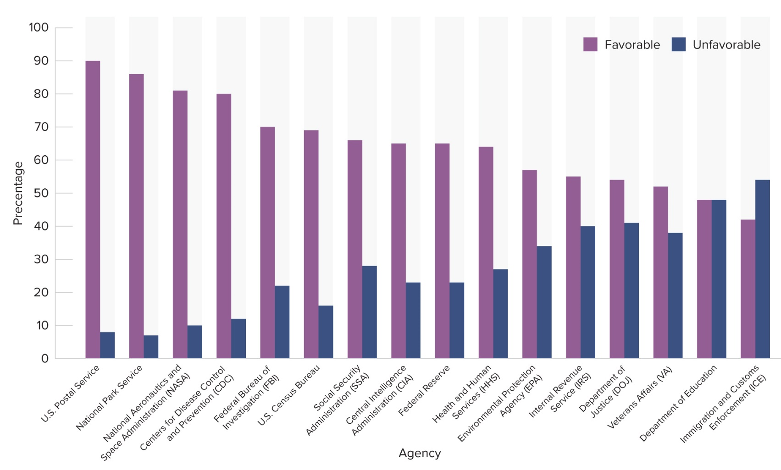
Figure 14.6 Public Views on Select Federal Agencies
Access the text alternative to slide image

Slide 45
The Best-Performing Bureaucracies
Characteristics of agencies that perform well:
Clearly-stated agency responsibilities.
Administrative flexibility and discretion for goal attainment.
Easily-measured agency goals.
Agency mission of “giving” versus “taking.”
i.e., Social Security Administration versus the IRS.
Another factor is high levels of support from elected officials, the media, and diverse groups of citizens for the legislated goal and the implementing agency.

Slide 46
Does Contracting-Out Improve Performance?
Political scientist Paul Light notes that because the full cost to the government for contracted work includes administrative costs and profit, the government in many cases pays more for work contracted out.
Federal bureaucracy also does not have enough bureaucrats to monitor government contractors sufficiently.
Lack of accountability is a growing concern; the Government Accountability Office (GAO) has determined contract management to be a high-risk function for numerous federal agencies.

Slide 47
Citizens’ Role in Bureaucratic Performance
Effectiveness of public policies depends on people’s knowledge of and compliance with the law.
Depends on their applying for the government programs for which they qualify and their conformity to the rules, regulations, standards, and directions of bureaucrats.
Symbiotic relationship is essential to the success of government.

Slide 48
Review 1
Then—The federal bureaucracy under President George Washington had three departments and two offices staffed with public servants engaged in mostly clerical work, serving a national population of 4 million.
Now—Approximately 4 million national bureaucrats—plus at least 13 million state and local bureaucrats, and private for-profit and nonprofit shadow bureaucrats—implement national public policies that serve the country’s population of over 323 million.

Slide 49
Review 2
Next:
Will the best and the brightest respond to the call to serve while elected officials denigrate the work and independence of federal bureaucrats?
Will the federal government address the transparency and accountability concerns raised by its expanding use of contracts and therefore shadow bureaucrats to implement public policies?

Slide 50
End of Main Content
Copyright 2022 © McGraw Hill LLC. All rights reserved. No reproduction or distribution without the prior written consent of McGraw Hill LLC.

Slide 51
Accessibility Content: Text Alternatives for Images

Slide 52
Figure 14.1 U.S. Government Organizational Chart - Text Alternative
Return to parent-slide containing image
Offices supporting the work of the legislative branch are the office of the Architect of the Capitol; the United States Botanic Garden; the Government Accountability Office; the Government Printing Office; the Library of Congress; and the Congressional Budget Office.
Offices of the judicial branch include the Administrative Office of the United States Courts; the Federal Judicial Center; and the United States Sentencing Commission.
In addition to the multiple policy offices of executive branch and the cabinet departments, there are at least fifty-six independent establishments and government corporations.
Return to parent-slide containing image

Slide 53
Figure 14.2 Race/National Origin of Federal Bureaucrats - Text Alternative
Return to parent-slide containing image
The data (in percentage) is as follows: white: 63; Black: 18; Asian or Pacific Islander: 7; Hispanic or Latino: 9; American Indian or Alaska Native: 2; and more than one race: 1.
Return to parent-slide containing image

Slide 54
Figure 14.3 Growth in Civilian Workforce - Text Alternative
Return to parent-slide containing image
Number of federal employees grew from 1.1 million in 1940 to a maximum of 3.1 million in 1990, shrinking since then to 2.8 million. (In 1945, during World War II, the number briefly stood at 3.5 million. By contrast, the number of state and local employees has grown from 1.9 million in 1940 to 19.5 million in 2010, shrinking to 19.4 million in 2016.
Return to parent-slide containing image

Slide 55
Figure 14.4 Trends in Federal Expenditures - Text Alternative
Return to parent-slide containing image
Bar graph shows the trends in federal expenditures from 1942 to 2016 and five year intervals in billions: 1940:136; 1945:1112; 1950:424; 1955:595; 1960:653; 1965:761; 1970: 1,030; 1975:1233; 1980; 1,496; 1985: 1762; 1990:2009; 1995:2075; 2000:2245; 2005:2722; 2010:3404; 2015:3336; 2016:3482.
Return to parent-slide containing image

Slide 56
Figure 14.5 Stages of the Policy Process: - Text Alternative
Return to parent-slide containing image
Web diagram showing the stages of the policy process, using the example of the Affordable Health Act (A C A). There are six stages of the policy process (each stage is dependent upon the previous stage) are: agenda setting, policy formulation, policy approval, resource allocation, policy implementation, and policy evaluation.
Return to parent-slide containing image

Slide 57
Figure 14.6 Public Views on Select Federal Agencies - Text Alternative
Return to parent-slide containing image
Horizontal axis represents agency, while vertical axis represents percentage ranging from 0 to 100 in increments of 10 and agency. The data (in percentage) is as follows: Favorable: United States postal service: 90; National Park Service: 85; National Aeronautics and Space Administration (NASA): 82; Centers for Disease Control and Prevention (CDC): 80; Federal Bureau of Investigation (FBI): 72; United States Census Bureau: 70; Social Security Administration (SSA): 68; Central Intelligence Administration (CIA): 66; Federal Reserve: 66; Health and Human Services (HHS): 64; Environment Protection Agency (EPA): 58; Internal Revenue Service (IRS): 56; Department of Justice (DOJ): 54; Veterans Affairs (VA): 52; Department of Education: 45; and Immigration and Customs Enforcement (ICE): 40. Unfavorable: United States postal service: 8; National Park Service: 6; National Aeronautics and Space Administration (NASA): 10; Centers for Disease Control and Prevention (CDC): 12; Federal Bureau of Investigation (FBI): 22; United States Census Bureau: 15; Social Security Administration: 30; Central Intelligence Administration (CIA): 25; Federal Reserve: 25; Health and Human Services (HHS): 30; Environment Protection Agency (EPA): 35; Internal Revenue Service (IRS): 42; Department of Justice (DOJ): 44; Veterans Affairs (VA): 40; Department of Education: 45; and Immigration and Customs Enforcement (ICE): 55. Note: All data is approximate.
Return to parent-slide containing image

